Slide 1
Machine Learning:
Learning from Data Using Linear Regression
Wright Analytics

Slide 2
Introduction
The linear regression model is a parametric learning method that can be used to model the relationship between a continuous dependent variable and one or more continuous independent variables
What do we exactly mean by “parametric learning method” and continuous independent variables? We will explain shortly

Slide 3
Introduction to Simple Linear Regression
Linear regression is a parametric learning method because the function used to “describe” or “model” the dependency between one dependent variable and one or more independent variables has a specific form that we assume is appropriate for the application
The form of the simple linear regression model is

Slide 4
Introduction to Simple Linear Regression
So the simple linear regression model is a line. And
is the conditional expectation of Y given X.
and are model parameters which are unknown
In linear regression, we estimate these parameters with continuous information

Slide 5
Introduction to Simple Linear Regression
Furthermore, we previously stated that is equal to a line. This assumption makes linear regression a parametric learning method
Note, this model is appropriate to apply when an obvious or approximate linear relationship is observed in a scatterplot of variables

Slide 6
Introduction to Multiple Linear Regression
Multiple linear regression is an extension of simple linear regression
Multiple linear regression can be considered when two or more independent variables are available
Multiple linear regression attempts to explain the impact each independent variable has on Y

Slide 7
Introduction to Multiple Linear Regression
The form of the multiple linear regression model is
and contains n independent variables where n is just a number
Again, the parameters are unknown and need to be estimated

Slide 8
A Note about Parameters and Continuity
In either the simple or multiple linear regression model, the parameters are real numbers as well as the continuous information contained in the dependent and independent variable(s)
The parameter estimates minimize a quantity called the residual sum of squares also known as the RSS
Once the parameters are known, we can make predictions

Slide 9
A Note about Parameters and Continuity
The idea of continuity, or continuous independent variables, is somewhat abstract. Since this is the case, we explain the concept of time as a continuous quantity
Many units can be used to measure time. Time can be expressed in years, months, weeks, days, hours, minutes, seconds, milliseconds, etc.
So time be continuously divided into smaller and smaller intervals/ units of measurement. This the concept of continuity

Slide 10
Project Results: Overview
In the project Machine Learning: Learning from Data Using Linear Regression, we describe how we search for a robust linear regression model we can use to predict a vehicle’s miles per gallon rating based on vehicle features
In the project, we present our modeling process and search for robust linear regression models

Slide 11
Project Results: Overview
The “best” linear regression models we were able to find contain transformed variables
Transformations of variables are often used to obtain linearity or capture non-linear relationships that appear to be present
During our search, we were able to find a robust simple and multiple linear regression model. We next discuss them

Slide 12
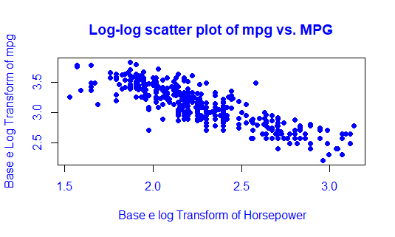
Project Results: Simple Linear Regression
We applied natural logarithm transforms to the data contained in the dependent mpg and independent variable horsepower to obtain linearity. The scatterplot found below shows this

Slide 13
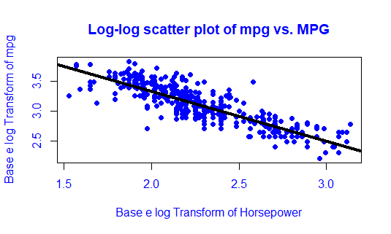
Project Results: Simple Linear Regression
A scatterplot with the estimated model is found below. The solid black line is the estimated model

Slide 14
Project Results: Simple Linear Regression
The estimated model written down is
where the ^ symbol indicates an estimation

Slide 15
Project Results: Simple Linear Regression
So for a car with that has a 150 horsepower engine, we expect that vehicles mpg to be
Note, the original values of the variable horsepower have been divided by 10
So the predicted value in the transformed scale is 2.74. Exponentiating the result yields 15.49 miles per gallon

Slide 16
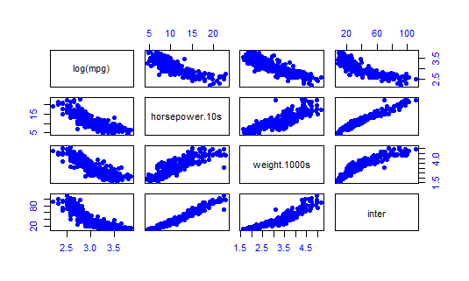
Project Results: Multiple Linear Regression
To assess linearity in multiple linear regression, we produce scatter plot matrices

Slide 17
Project Results: Multiple Linear Regression
Looking at the top row of the plot, we see that the relationship between the natural log of mpg and independent variables horsepower, weight, and the interaction of horsepower and weight is linear
The other variables we include in the model are American.Dummy, European.Dummy, and X4.cylinders.dummy which are indicator variables that represent different categories.

Slide 18
Project Results: Multiple Linear Regression
American.Dummy takes on a value of 1 if the vehicle is manufactured in America. It takes on a value of 0 if the vehicle is manufactured in Japan or Europe
European.Dummy takes takes on a value of 1 if the vehicle is manufactured in Europe. It takes on a value of 0 if the vehicle is manufactured in Japan or America

Slide 19
Project Results: Multiple Linear Regression
X4.cylinders.dummy takes on a value of 1 if the vehicle’s engine has four cylinders. It takes on a value of 0 if it does not.
The idea of dummy/indicator variables is that they can be used to quantify how certain qualities of an observation impact the dependent variable. Qualities are not numbers. However, they can be represented with numbers

Slide 20
Project Results: Multiple Linear Regression
The estimated multiple linear regression we obtained is
Where X.1 is American.Dummy, X.2 is European.Dummy, X.3 is X4.cylinders.dummy, X.4 is horsepower, and X.5 is weight
Note, the original values in horsepower have been divided by 10. Likewise the original values of weight have been divided by 1000

Slide 21
Project Results: Multiple Linear Regression
So if a vehicle manufactured in America, weighs 3500 pounds, has a 155-horsepower engine, and is not a four cylinder we expect that vehicle to get
The predicted value in the transformed scale is 2.788. Exponentiating the result yields 16.28 mpg

