Slide 1
Machine Learning: Using the Logistic Regression Model to Predict Coronary Heart Disease
Wright Analytics

Slide 2
Introduction
Logistic regression is a parametric learning method that can be used to used to model a qualitative variable with one or more continuous independent or indicator variables. Moreover, the dependent variable contains two levels. Since this is the case, the levels are often represented with binary coding. Ones and zeroes
So Y = 1 or Y = 0 when the qualitative levels are given a binary coding

Slide 3
Introduction
The occurrence of Y = 1 usually represents the event of success in some process/phenomena the modeler is studying
On the other hand, the occurrence of Y = 0 usually represents the event of failure in the same process/phenomena the modeler studying
One can think of Y = 1 as a “success” response and Y = 0 as a “failure” response

Slide 4
Introduction to Logistic Regression
The logistic regression model is similar to the linear regression
The difference between models is mainly the modeling objective.
Linear regression is used to model an unbounded continuous dependent variable whereas the logistic regression model attempts to model a dependent variable that contains categories

Slide 5
Introduction to Logistic Regression
The dependent variable in linear regression is unbounded because it not constrained to some condition. It can take on any real value.
When the dependent variable is qualitative, or Y is coded in binary, the objective is to estimate the probability of Y = 1
Probability always lies in the interval (0,1)

Slide 6
Introduction to Logistic Regression
Since probability always lies in the interval (0,1), one can say that probability constrained to the interval
In fact, the logistic regression model outputs conditional probabilities
The idea of conditional probability is like the conditional mean that we explain in our “Machine Learning: Learning from Data Using Linear Regression” presentation

Slide 7
Introduction to Logistic Regression
The logit form of the logistic regression model is
The logit form of the multinomial logistic regression model is

Slide 8
Introduction to Logistic Regression
To obtain the probability form of the model, we exponentiate both equations and solve for p
The probability form of the logistic regression model is

Slide 9
Introduction to Logistic Regression
The probability form of the multinomial logistic regression model is
We predict Y = 1 by using the probability form of the model. Remember, the probability form of the model outputs conditional probabilities

Slide 10
Introduction to Logistic Regression
To be brief, conditional probability is written as
Where X and Y are two different events where X has already occurred, or been observed, and Y has not yet occurred
We use conditional probability to answer questions like, “what is the probability Y occurs given we already know that X happened?”

Slide 11
Introduction to Logistic Regression
Again, we use the probability form of the logistic regression model to determine whether Y = 1 or Y = 0 based on the values of the independent variable(s)
If p > c when we use the model to estimate a probability for an observation X, where c is just a constant in the interval (0,1), then we conclude that Y = 1. If p is not greater than c, then observation X’s Y label is zero
The number c is called a threshold

Slide 12
Brief Summary of Logistic Regression
The logistic regression model is a parametric learning method that assumes linearity between the qualitative variable, often coded in binary, and the independent variable(s)
There are two forms of the model: logit form and probability form
The logistic regression model outputs conditional probabilities based on the value of X and are used to label an observation X as either Y = 0 or Y = 1

Slide 13
Project Results: Overview
In our project “Machine Learning: Using the Logistic Regression Model to Predict Coronary Heart Disease”, we analyze data from the Framingham Heart Study
The data set we obtained contains medical information from Framingham, Massachusetts residents who participated in the ongoing study

Slide 14
Project Results: Overview
The data set we obtained contained various variables that numerically represent major risk factors for absolute short-term coronary heart disease (CHD)
The binary dependent variable we modeled is Risk. Risk = 1 indicates that the patient is at risk of developing fatal or nonfatal CHD within ten years or less. Risk = 0 if the patient is not at risk

Slide 15
Project Results: Empirical Logit Plots
Empirical logit plots are visualization tools that can be used to assess the linearity condition between the dependent and continuous independent variable(s). Additionally, dependent variable and independent indicator variables that represent categories in binary
It is not required to assess linearity for indicator variables because it is automatic. However, they can show us the direction and magnitude between the dependent variable and indicator variable

Slide 16
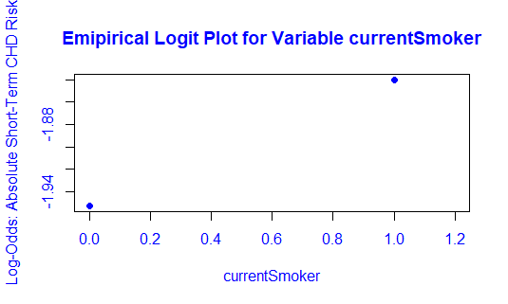
Project Results: Empirical Logit Plots
The variable currentSmoker indicates whether the patient was a current smoker at the time of their doctor visit or not. currentSmoker = 1 if yes. currentSmoker = 0 if not

Slide 17
Project Results: Empirical Logit Plots
This empirical logit plot shows that smokers may have a higher risk of developing fatal or nonfatal CHD within the next ten years as compared to non-smokers
It is important to note that we cannot conclude that smoking causes an increased risk of the condition in people based on the plot. We can only conclude that the relationship between the logit form of the model is linear and positively associated with the act of smoking

Slide 18
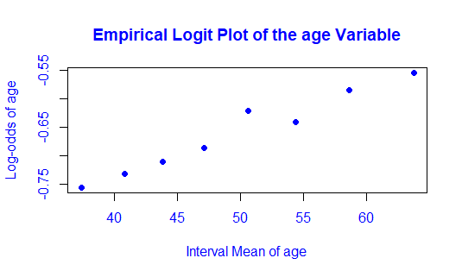
Project Results: Empirical Logit Plots
The variable age is a continuous variable that contains the ages of the patients in the study.

Slide 19
Project Results: Empirical Logit Plots
The plot shows that advancing age may be a risk factor of developing fatal or nonfatal CHD within the next ten years
Again, we cannot conclude that advancing age causes an increased risk of developing the condition in people based on the plot. We can only conclude that the relationship between the logit form of the model is linear and positively associated with growing older

Slide 20
Project Results: Major CHD Risk Factors
In our research we found that advancing age, sex-specific advancing age, certain levels of body mass index (BMI), smoking, diabetes, and certain levels of systolic blood pressure are thought to be major risk factors that contribute to development of coronary heart disease in patients.
Based on our research and intuition, we built a logistic regression model where the risk factors listed above were used as independent variables in the model.

Slide 21
Project Results: The Independent Variables
X.1 indicates the sex of the patient. X.1 = 1 if the patient is male.
X.1 = 0 if the patient is female.
X.2 and is the integer age of the patient.
X.3. represents males who are forty-five and older. This variable was engineered to represent sex-specific advancing age. X.3 = 1 if the patient is male and forty-five or older. X.3 = 0 if the patient is female or the patient is male but younger than forty-five

Slide 22
Project Results: The Independent Variables
X.4. It represents women who are fifty-five and older. X.4 = 1 if the patient is female and fifty-five or older. X.4 = 0 if the patient is male or the patient is female but younger than fifty-five. This variable was engineered
X.5 and is the patient’s body mass index
X.6 indicates if the patient is diabetic or not. X.6 = 1 if the patient is diabetic. X.6 = 0 if they are not
X.7 represents the number of cigarettes smoked by the patient per day on average

Slide 23
Project Results: The Independent Variables
X.8 indicates the smoking status of the patient. X.8 = 1 if the patient is a current smoker. X.8 = 0 otherwise. It represents the act of smoking. NOT how many cigarettes the patient smokes
X.9 is the patient’s systolic blood pressure
X.10 indicates if the patient previously had hypertension. X.10 = 1 if they did. X.10 = 0 otherwise
X.11 is the patient’s total cholesterol level
X.12 indicates if the patient previously had a stroke or not. X.12 = 1 if they did. X.12 = 0 if they didn’t

Slide 24
Project Results: The Model
The model we obtained and use for predictions is

Slide 25
Project Results: A Prediction
In the conclusion of our project, we use the model to determine if a fifty-year-old male who has a body mass index of 30, is diabetic, smokes 20 cigarettes per day on average, has a systolic blood pressure reading of 150, has a history of stroke, is hypertensive and total cholesterol level of 128. Plugging these values in to the model yields

Slide 26
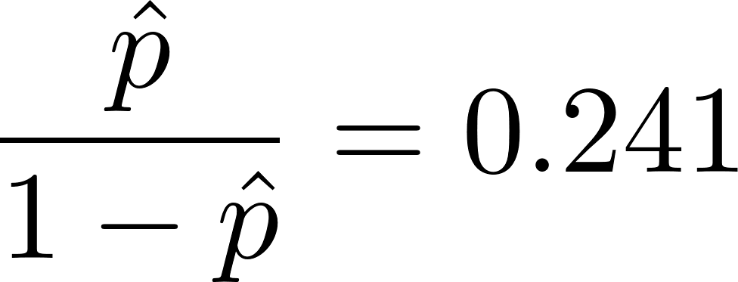
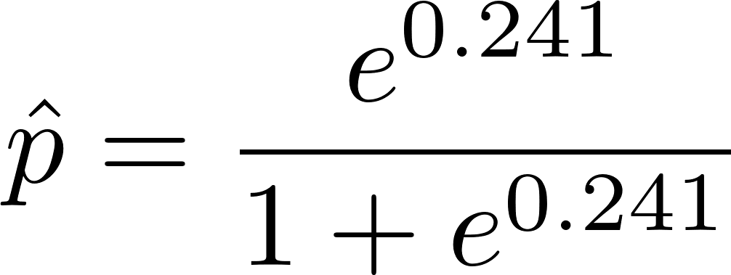
Project Results: A Prediction
The estimated logit model returns 0.241. Solving for p we obtain

Slide 27
Project Results: A Prediction
Which translates to a 56.0% chance the patient will suffer from fatal or nonfatal CHD.
This probability was significantly higher than the threshold value of c that we used. This c optimized the accuracy of the model. Therefore, for this patient, it is highly likely he will develop CHD within the next years if he does not take or follow any risk mitigation steps

